Slide 1



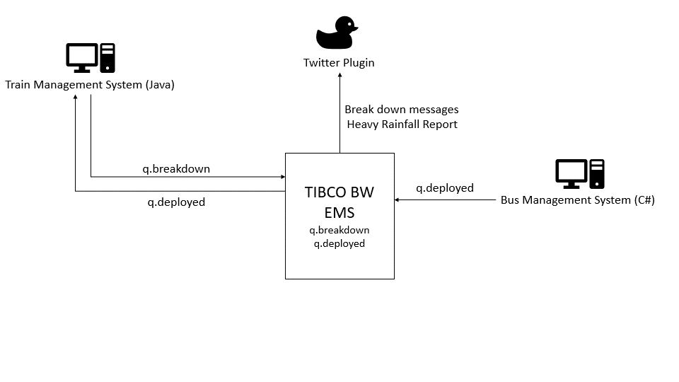
Bus Management System (C#)
Schedule Management Web Service (PHP)
Train Management System (Java)
Twitter Plugin
Get nearest Bus Depot Web Service (Java)
Bus Depot JMS Address
Weather API

Slide 2
Twitter Plugin
Train Management System (Java)
Break down messages
Heavy Rainfall Report
q.breakdown
TIBCO BW
EMS
q.breakdown
q.deployed
q.deployed
q.deployed
Bus Management System (C#)

